Slide 1
Verification and Validation of
FISPACT-II & General-Purpose Nuclear Data Libraries
M. Fleming, J-Ch. Sublet, M. Gilbert,
J. Kopecky¹, A. Koning², D. Rochman³
¹JUKO Research
²IAEA Nuclear Data Section
³Paul Scherrer Institut
UK National Conference on Applied Radiation Metrology
NPL, Teddington, UK
11 November 2015

Slide 2
Overview
Summary of new FISPACT-II code features, data libraries
Comments on fission decay heat measurements & simulations
Results from FISPACT-II V&V on fission pulse decay heat
Fusion decay heat experiments and validation
Uncertainty quantification and propagation by coupling technological nuclear data generation (TENDL and GEFY) with FISPACT-II
Proposed areas for collaboration

Slide 3
Snapshot of FISPACT-II
FISPACT-II has been developed by UKAEA to provide nuclear observables, using the most advanced nuclear reaction physics, for a wide variety of applications
Some features:
  Fine grid data for 5 incident particles, nFY, sFY, oFY, any major DD…
  All ENDF-6 data including full processing of TENDL-2014
  Full variance-covariance treatment
  Modern LSODES-2003 solver
  Resolved and unresolved self-shielding through PTs
  DPA, kerma, PKA, gas production, yields up to GeV
  Monte-carlo sensitivity analysis
  Multi-irradiation/cooling step pathway analysis
  Thin/thick target yields
  Temperatures from 0K to 1200K, and above to kT=5, 30, 100 keV

Slide 4
Some new features in 3-00
Continuous development from 2011-present. Release follows 2-20-10 release of June 2014. New release contains more features:
  POWER density normalisation to complete kerma for all reactions (allows normalisation for reactor simulations)
  Energy-dependent fission yield collapse (more than 40 incident energies) using GEFY n- g- p- d- a- FY
  Multiple-particle, simultaneous irradiations
  Emitted spectra for primary knock-on atoms (PKAs) for all reaction products
  Temperature-dependent plasma reaction rate calculations (fusion, stellar nucleosynthesis, etc.)
  Improved pathway routines, tolerances, covariance processing, visualisation methods, data outputs and more…
  Bug-fixes, responses to user requests, etc.

Slide 5
Fission pulse decay heat
While burn-up codes handle a small sub-set, many nuclides must be tracked to simulate decay heat
The integral quantity hides a great deal which can be very questionable (see later)
Many nuclides have (or had) poorly explored decay schemes. Some fixed by international effort on TAGS, fewer implemented, particularly in JEFF-3.1.1 (3.2?) decay data

Slide 6
More warnings
There is no ‘pulse’ experiment for decay heat, but many different finite irradiations
  Right: ORNL ‘Dickens’ ²⁴¹Pu data from 1-1000 s irradiations
  To get to pulse, correct using C(pulse)/C(finite)
  Stitch together for results
There is no Tobias experiment
  Tobias is statistical analysis of pre-1989 data (no Lowell etc.)
  Many similar experiments had systematic faults -> Tobias
  Stitching of multiple irradiations, spectra, etc. gives ‘Frankenstein’
²⁴¹Pu DH pulse with typical method of displaying as MeV/fission * cooling time

Slide 7
Standard pulse simulations
Top (left to right): thermal U5, P9, P1 total and gamma heat
Bottom (left to right): fast U3, U8, P9 total and gamma heat
Note Pandemonium still in JEFF-3.1.1 and UKAEA DD-12 for gamma

Slide 8
Non-pulse simulations
Top (left to right): ZEBRA long P9, HERALD P9, GODIVA-II Th232
Bottom (left to right): LANL U5 LHBoC, Studsvik U5 beta, CEA U5 calor
As with pulse, these are a small subset of those in CCFE-R(15)28

Slide 9
Probe the data: DD
Fix the nFY (all JEFF-3.1.1 for example) and vary the decay data to probe for differences
Right: ²³⁹Pu beta (top) and gamma (bottom) heat at 100 s cooling – note large variation in decay files
  Nominal values and ratio to one, here ENDF/B-VII.1
Useful check to see what evaluations have been performed and where some libraries lag behind (or make different evaluations)

Slide 10
Probe the data: nFY
Other option: use the same DD and vary the nFY
Right: ²³³U fast fission pulse beta (top) and gamma (bottom) at 10 s cooling
  Nominal values and ratio to an example, here JEFF-3.1.1
This is all over the place! Note that the same DD is used in each simulation, but varied independent fission yields
Minor actinides all show the same pattern

Slide 11
Fusion decay heat V&V
Rather than nFY, we rely upon the n-incident cross sections and reaction rates
FNS (JAEA) and FNG (ENEA) ²H beam onto ³H-Ti target for ~14 MeV source
Right: total decay heat from five minute irradiation of Ni at ~1E10 n/s on target
  Only TENDL has ^{62m}Co isomer which dominates heat at 100-3000 s (~1min - 1hour)
  Only TENDL has complete covariance data for all channels

Slide 12
Some interesting results
FNS 7 hour irradiation of Ta (also performed at FNG with similar results)
Significant under-prediction at 1 week – 1 year, highly likely to be under-predicted at further cooling
¹⁸²Ta strongly dominant and only production path is:
¹⁸¹Ta(n,γ)¹⁸²Ta
ENDF/B-VII.1 is better, but…

Slide 13
Tantalum capture
Tantalum capture is an example where we have 3 unique evaluations:
  IRDFF (which is JENDL/D-99)
  ENDF/B-VII.1 (which is a TALYS-1.0 calculation)
  TALYS-1.7 (the best of the lot)
TENDL-2014 copies IRDFF here, under-predicting
IAEA NDS taking on-board findings to update/correct IRDFF (most likely with TALYS calculations)

Slide 14
Uncertainty quantification
FISPACT-II performs full covariance collapse with whatever is available (e.g. MF=33), but outside TENDL it is typically poor
TENDL produces UQ through ‘total Monte-Carlo’ (TMC) which is a sampling of physical parameters within models
  Sampling gives varied data files
  Statistical analysis of files gives UQ
Alternative is to sample parameters directly for simulation, through ‘dummy files’ for example
Right: example with sampling of GEF parameters for nFY UQP in decay heat simulation

Slide 15
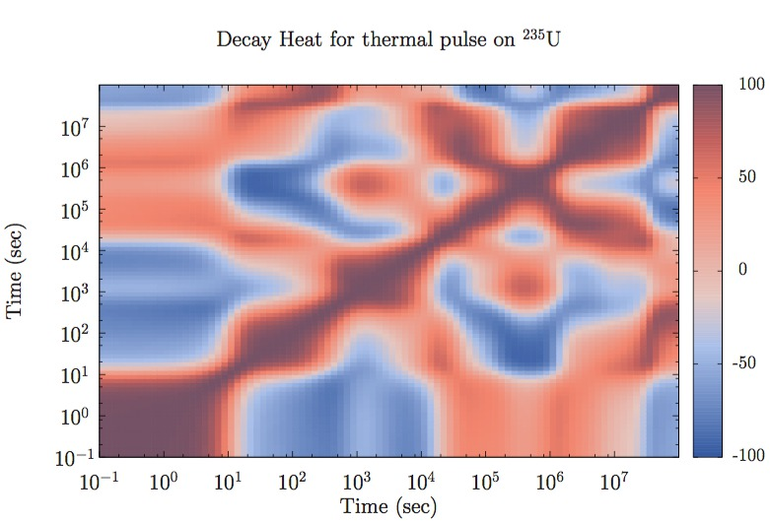
Total Monte-Carlo UQP
TMC opens up many robust UQP opportunities no available with legacy, incomplete, static approaches
  Sample over multiple parameter sets to fully consider correlations
  Tackle otherwise intractable questions, e.g. DDX emitted spectra
  Completeness is a minimum expectation for UQP – just doing a couple preferred nuclides is insufficient
Bayesian analysis with TMC offers more options – technological UQP for application specific data
Right: time-correlation matrix for DH uncertainty due to nFY

Slide 16
FISPACT-II V&V
Several V&V reports out recently, CCFE-R(15)25-28, UKAEA-R(15)29-33, covering:
  Fission decay heat and inventory simulations
  Fusion decay heat simulations
  Integro-differential over accelerator-driven neutron sources
  Astrophysical MACS with TENDL-2014, ENDF/B-VII.1, JENDL-4.0
  UKAEA thermal/RI compilation, systematic and statistical validation of TENDL-2014
  Material handbooks with PKA spectra for fusion, LWR, FBR, HFR reactor designs
Available through website:
http://www.ccfe.ac.uk/fispact.aspx

Slide 17
Future directions
Free licensing for UK universities, ‘special partners’, research licenses for many others
Will be distributed through OECD NEA Data Bank with free non-commercial licenses for all member states
Integration of FISPACT-II within larger nuclear simulation systems
  Desire to perform full assembly, inventory benchmarking in collaboration with industry standard diffusion/transport codes
Develop new features based on needs of users
Fully employ TMC, BMC UQP for next-generation simulations, fuel stewardship analysis, satisfy various regulators…

