Slide 1
General-purpose Verification and Validation for Nuclear Observables
M. Fleming, J-Ch. Sublet, M. Gilbert,
J. Kopecky¹, A. Koning², D. Rochman³
¹JUKO Research
²IAEA Nuclear Data Section
³Paul Scherrer Institut
OECD NEA Data Week
Benchmarking & Validation
Paris 3 December 2015

Slide 2
Overview
Summary of new FISPACT-II code features, data libraries
Run-through of FISPACT-II and nuclear data validations
  Fission decay heat (pulse and finite irradiations)
  Integro-differential from fusion/accelerator neutron sources
  s-process nucleosynthesis, MACS, KADoNiS
  Checks on RI, thermal, systematics for 14 MeV
Some comments, future directions

Slide 3
Snapshot of FISPACT-II
FISPACT-II has been developed by UKAEA to provide nuclear observables, using the most advanced nuclear reaction physics, for a wide variety of applications
Some features:
  Fine grid data for 5 incident particles, nFY, sFY, oFY, any major DD…
  All ENDF-6 data including full processing of TENDL-2014
  Full variance-covariance treatment
  Modern LSODES-2003 solver
  Resolved and unresolved self-shielding through PTs
  DPA, kerma, PKA, gas production, yields up to GeV
  Monte-carlo sensitivity analysis
  Multi-irradiation/cooling step pathway analysis
  Thin/thick target yields
  Temperatures from 0K to 1200K, and above to kT=5, 30, 100 keV

Slide 4
Some new features in 3-00
Continuous development from 2011-present. Release follows 2-20-10 release of June 2014. New release contains more features:
  POWER density normalisation to complete kerma for all reactions (allows normalisation for reactor simulations)
  Energy-dependent fission yield collapse (more than 40 incident energies) using GEFY n- g- p- d- a- FY
  Multiple-particle, simultaneous irradiations
  Emitted spectra for primary knock-on atoms (PKAs) for all reaction products
  Temperature-dependent plasma reaction rate calculations (fusion, stellar nucleosynthesis, etc.)
  Improved pathway routines, tolerances, covariance processing, visualisation methods, data outputs and more…
  Bug-fixes, responses to user requests, etc.

Slide 5
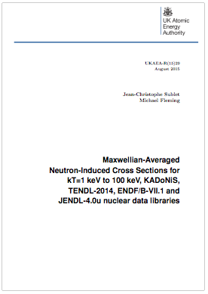
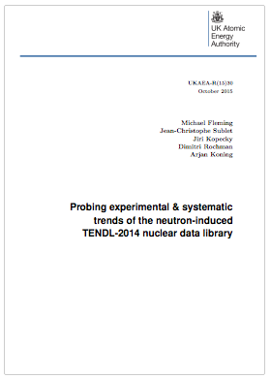
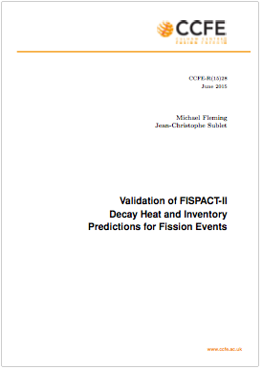
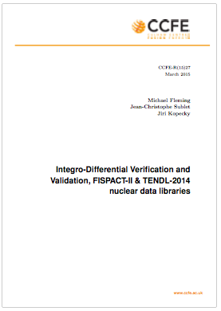
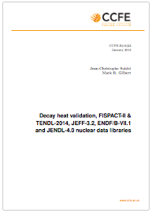
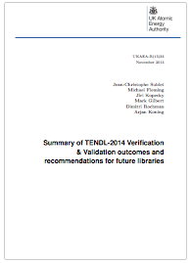
General validation
Summaries which follow come from reports:
  CCFE-R(15)25 Fusion decay heat
  CCFE-R(15)27 Integral fusion
  CCFE-R(15)28 Fission decay heat
  UKAEA-R(15)29 Astro s-process
  UKAEA-R(15)30 RI/therm/systematics
  UKAEA-R(15)35 Summary report

Slide 6
Standard pulse simulations
Top (left to right): thermal U5, P9, P1 total and gamma heat
Bottom (left to right): fast U3, U8, P9 total and gamma heat
Note Pandemonium still in JEFF-3.1.1 for gamma (3.2?)

Slide 7
Non-pulse simulations
Top (left to right): ZEBRA long P9, HERALD P9, GODIVA-II Th232
Bottom (left to right): LANL U5 LHBoC, Studsvik U5 beta, CEA U5 calor
As with pulse, these are a small subset of those in CCFE-R(15)28

Slide 8
Probe the data: DD
Fix the nFY (all JEFF-3.1.1 for example) and vary the decay data to probe for differences
Right: ²³⁹Pu beta (top) and gamma (bottom) heat at 100 s cooling – note large variation in decay files
  Nominal values and ratio to one, here ENDF/B-VII.1
Useful check to see what evaluations have been performed and where some libraries lag behind (or make different evaluations)

Slide 9
Probe the data: nFY
Other option: use the same DD and vary the nFY
Right: ²³³U fast fission pulse beta (top) and gamma (bottom) at 10 s cooling
  Nominal values and ratio to an example, here JEFF-3.1.1
This is all over the place! Note that the same DD is used in each simulation, but varied independent fission yields
Minor actinides all show the same pattern

Slide 10
Fusion decay heat V&V
Rather than nFY, we rely upon the n-incident cross sections and reaction rates
FNS (JAEA) and FNG (ENEA) ²H beam onto ³H-Ti target for ~14 MeV source
Right: total decay heat from five minute irradiation of Ni at ~1E10 n/s on target
  Only TENDL has ^{62m}Co isomer which dominates heat at 100-3000 s (~1min - 1hour)
  Only TENDL has complete covariance data for all channels

Slide 11
Some interesting results
FNS 7 hour irradiation of Ta (also performed at FNG with similar results)
Significant under-prediction at 1 week – 1 year, highly likely to be under-predicted at further cooling
¹⁸²Ta strongly dominant and only production path is:
¹⁸¹Ta(n,γ)¹⁸²Ta
ENDF/B-VII.1 is better, but…

Slide 12
Tantalum capture
Tantalum capture is an example where we have a few unique evaluations:
  IRDFF (which is JENDL/D-99)
  ENDF/B-VII.1 (which is a TALYS-1.0 calculation)
  TALYS-1.7 (the best of the lot)
  JEFF-3.2 (strangely not in agreement with exp?)
TENDL-2014 copies IRDFF here, under-predicting
IAEA NDS taking on-board findings to update/correct IRDFF (most likely with TALYS calculations)

Slide 13
s-Process nucleosynthesis
TENDL-2014 adds targets to fully compare against KADoNiS
A few problematic differences, and several observations from temperature-dep studies
Often, winner resonance takes all

Slide 14
Global therm/RI/MACS/sys.
Therm/RI excellent with few typos (often also in legacy files!)
MACS better than any other – one typo in Hg200, few questionables
Systematics for 14 MeV agree within known regimes – outside we need more/better systematics (i.e. (n,g) = 1mb?)

Slide 15
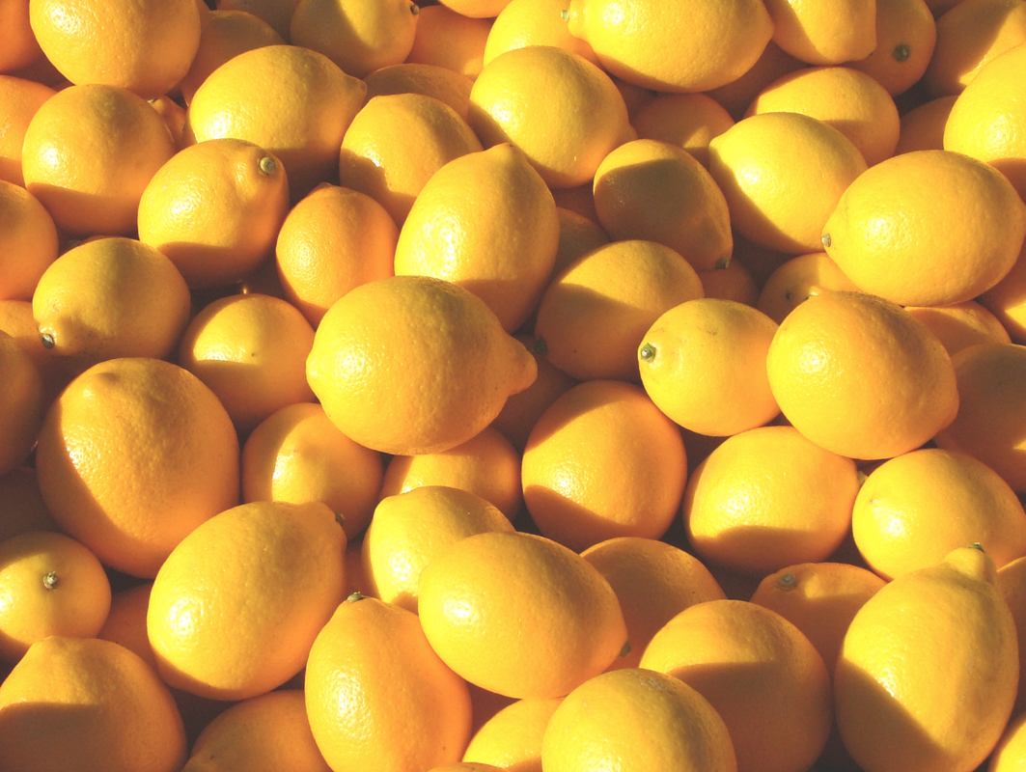
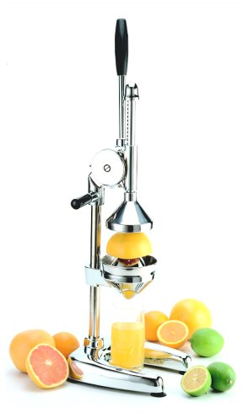

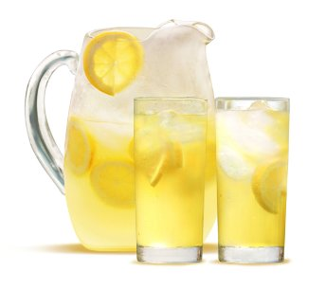
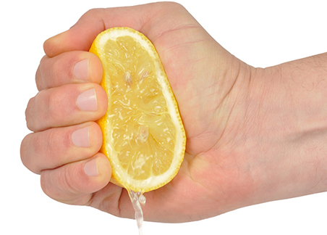
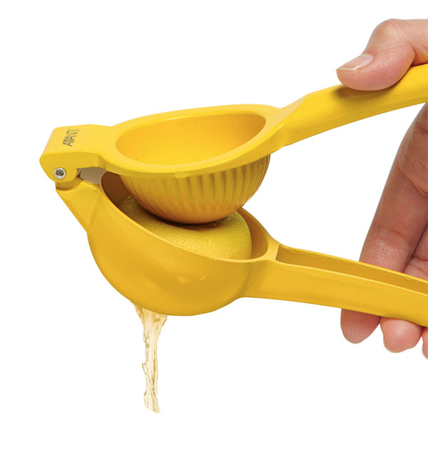
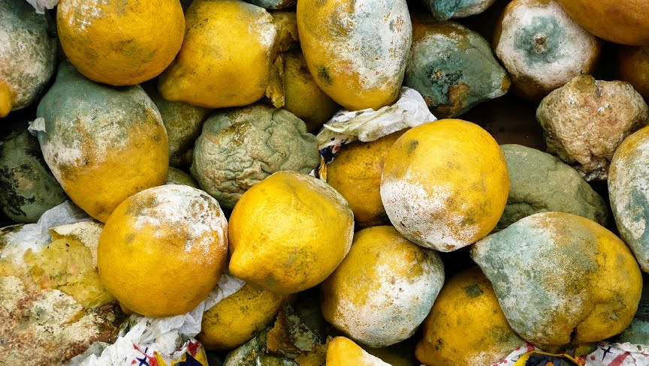
Nuclear Lemonade

Slide 16
Future directions
Nucleosynthesis with p/r-process reactions and TENDL
  TALYS is not enough (!) we require resonance data where possible or some method for reproducing Maxwellian-averaged resonance data
    Giants will often contribute a lion’s share
  For non-s-process, this is mostly the regions without measured resonances…
Fully implementing ND generation to simulation loop to better probe ND questions (outside criticality, which is relatively more mature)
  Although, nFY? See next slide…
  Very strong need in activation, burn-up analysis, etc.
Employing UQP fully into time-dependent simulations (TMC, BMC, coupled with FISPACT-II)

Slide 17
U233 nFY examples
ENDF/B-VII.1
JEFF-3.1.1
GEFY-5.2
Too far? Man-made bondaries?
N=Z Diagonals?
Far enough?

Slide 18

Legacy, evaluated nFY

Slide 19
GEFY-5.2

