Slide 1
Bayesian Monte-Carlo and Experimental Uncertainties
M. Fleming
UK Atomic Energy Authority
OECD NEA Data Week
JEFF Decay Data and Fission Yields Working Group
Paris 27 April 2016

Slide 2


Some starting comments
Total-Monte-Carlo in this presentation refers to:
  Random sampling of nuclear data files using input parameter variation, followed by simulation with sampled random nuclear data files
TMC necessarily involves many random files which will never be validated (or read by a human?). Quality of the TMC is only as good as the quality of these (perturbed parameter) files which…
You think look like this…
But may look like this…

Slide 3
Bayesian TMC
Bayesian TMC in this presentation refers to:
  Use of optimisation algorithm to select best input parameters for
  ND generating code, so as to best match some experimental or
  evaluated data
This approach has been developed by several, to produce sets of fission yield files for TMC uncertainty calculations
(cf https://tendl.web.psi.ch/tendl_2015/randomYields.html)
The complexity comes from definition of a fitness function, choice of optimisation algorithm and parameter updating method

Slide 4
A few cautionary thoughts
Fission yield simulation codes must be run to convergence. Depending on how far you wish to simulate
The number of randomly sampled files required to converge some observables is not a priori obvious – 10 per parameter? 20? More?
GEF may be able to match the yields of evaluated files quite well, since these are (hopefully) physically consistent, but how do we reconcile uncertainties which are not based on model/theory?
As just mentioned, a few ‘unique’ files may slip through generation and some simple checks, but will skew results, particularly variances which are sensitive to outliers

Slide 5
Convergence with TMC
  Convergence of GEF calculations for U235_th nFY (1.0E+05 to 1.0E+08)

Slide 6
Convergence with TMC
  2. Performing enough samplings to converge observables
  Below: nFY TMC with PWR UO2 assembly averaged Nd148 at shutdown, after 40 GWd/tn burn-up (how many samples/parameter?)

Slide 7
GEF vs Evaluated
There are some fundamentally different approaches which are difficult to reconcile:
  Build the best physical model based on marriage of theory and semi-empirical models
  Perform sophisticated statistical analysis of experimental data and generate best fit
  Match some experiments from your reactor of interest
It will be very challenging for a physically consistent model to reproduce tweaked values, and impossible for it to reproduce the uncertainties with extreme discontinuities
However, legacy approaches will continue to be used and users want UQP, so attempting to fit GEF results to evaluated data has value.

Slide 8

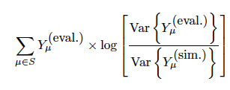
GEF and Evaluated Unc.
To fit the evaluated yields, there is a natural fitness function:
At least two sources for uncertainties to match: evaluation or experiment
  Experiment is preferable for many reasons, but this is not for the faint-hearted. Unwinding cumulative yields, differences between decay files, experimental bias for good or bad… I am not so brave…
  Choosing the evaluated data is a much easier task. Moreover, reactor operators are (probably) not going to prefer GEF-calculated uncertainties for their fission products of interest, irrespective of quality.
For this we define a fitness function:

Slide 9
Yield sensitivities
To best fit the evaluated variances, some updating algorithm for the parameter variances is required, using the sensitivity of the yields to the input parameters:

Slide 10
Updating
Approach prototyped is quite simple:
  Mean values fixed as end-of-optimisation values from DR BMC method
  Variances taken as default GEF ratios of default GEF parameters
  Sets of files are generated with Gaussian samples over all parameters
  Statistical collapse of sampled files compared with evaluated data
  Variances are gently nudged based on sampled-to-evaluated fitness of all reasonably converged yields
  Continue until update has no effect
Result depends on fitness function, path to minimum and target

Slide 11
Variance update prototype
Can design parameter updating algorithms to push input variances toward reproducing evaluated uncertainties, but only as far as the physical model can cooperate with the evaluated uncertainties…

Slide 12
Comments on covariances
Independent covariances intuitive based on simulation of fission events (independent correlation chart for Nd148 GEFY-5.3 U5_th)

Slide 13
Comments on covariances
Cumulative covariances and covariances from full irradiation scenarios show completely different trends (assembly 40 GWd/tn)

Slide 14
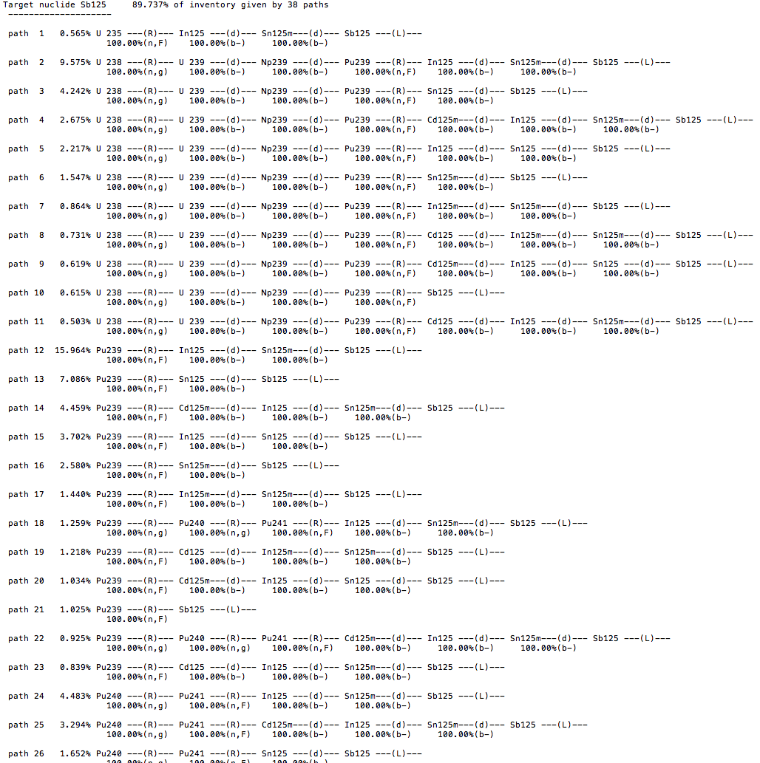
FISPACT-II UQP
FISPACT-II can provide full, reaction-pathway-based production uncertainties for nuclide inventories, as well as TMC methods
Typically inventory codes are tuned to follow select FPs, pseudo-FPs, set fission yields, ratios of fissions, etc
FISPACT-II can be reigned in or let loose per user requirements
Can probe as far/deep as you dare to go

Slide 15
FISPACT-II and nFY TMC
FISPACT-II can be used to fully sample random independent yield files with any decay library, propagating uncertainties through full fuel life-cycle

Slide 16
Conclusions
Fission yields for reactor operation have uncertainties due to measurement techniques, interest in nuclides and choices for normalisation methods
Two different evaluations (ENDF v JEFF) not only disagree, but will intentionally, always disagree for nuclides of importance to them
A physically-faithful code with natural parameter variation cannot be reconciled with discontinuities of evaluated uncertainties
A physically-faithful code with massaged parameter variation may complement uncertainties and correlations for evaluated methods…
To couple with full, unconstrained nuclear data we must have open, unconstrained simulation tools, such as FISPACT-II

