Slide 1
UKAEA work in fission yields and decay data
M. Fleming, J-Ch. Sublet, D. Rochman¹, K-H. Schmidt²
UK Atomic Energy Authority
¹Paul Scherrer Institut
²Centre Etudes Nucléaires de Bordeaux Gradignan
Technical Meeting on Fission Yields
IAEA NDS, Vienna, 23-26 May 2016

Slide 2
Schedule
Snapshot of FISPACT-II
Decay heat simulations, standards
  Brief review of methods, FISPACT-II, tools, results, comparisons
  Inclusion of ENDF/B-VIII.1β and JENDL-2015/DDF, comments on improvements
Bayesian Monte-Carlo method for GEF-based uncertainty quantification & propagation matching evaluated uncertainties
  Independent v cumulative, comments
  Unresolved issue: consistency of correlations between trackers (<1%) and general FPs (~5%+)
BMC UQP, decay heat, post-irradiation inventories, outlooks
Reaction rate covariances + BMC nFY simultaneous sampling

Slide 3

Snapshot of FISPACT-II
Some features:
  Fine grid data for 5 incident particles, nFY, sFY, oFY and any major DD…
  All ENDF-6 data including full processing of TENDL-2015
  Full variance-covariance uncertainty quantification and propagation (TENDL & legacy libraries)
  Modern LSODES solver
  Resolved and unresolved self-shielding through PTs
  DPA, kerma, PKA, gas production, yields up to GeV
  Monte-carlo sensitivity analysis
  Multi-irradiation/cooling step pathway analysis
  Thin/thick target yields
  Temperatures from 0K to 1200K, and above to kT=5, 30, 100 keV
FISPACT-II has been developed by UKAEA to provide nuclear observables, using the most advanced nuclear reaction physics, for a wide variety of applications

Slide 4
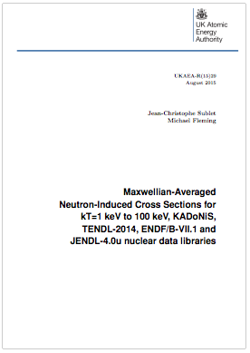
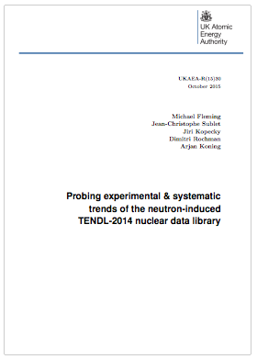
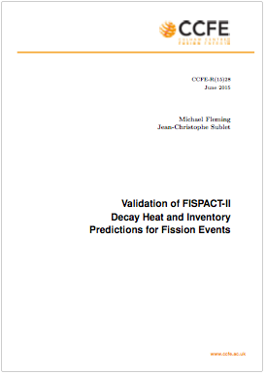
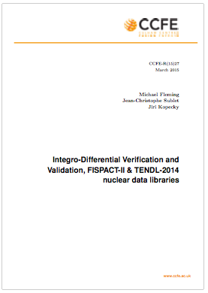
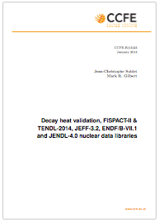
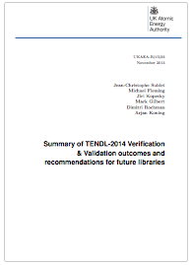
General validation
FISPACT-II and libraries are subject of various validation reports:
  CCFE-R(15)25 Fusion decay heat
  CCFE-R(15)27 Integral fusion
  CCFE-R(15)28 Fission decay heat
  UKAEA-R(15)29 Astro s-process
  UKAEA-R(15)30 RI/therm/systematics
  UKAEA-R(15)35 Summary report

Slide 5
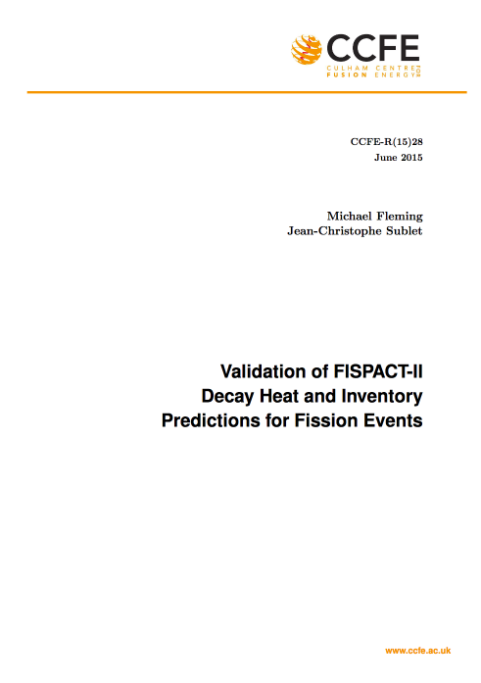
Decay heat benchmarks
Subject of recent UKAEA validation report
M. Fleming, J-Ch. Sublet. Validation of FISPACT-II Decay Heat and Inventory Predictions for Fission Events. CCFE-R(15)28
http://www.ccfe.ac.uk/assets/documents/easy/CCFE-R(15)28.pdf
Series of decay heat measurements from fission ‘pulses’ and longer duration irradiations
  Calorimetric, beta, gamma, measurements, many techniques, varying quality
  Statistical meta-analysis (eg Tobias, ANSI/ANS-5.1) with selection of experiments and human weightings

Slide 6
Standard pulse simulations
Top (left to right): thermal U5, P9, P1 total and gamma heat
Bottom (left to right): fast U3, U8, P9 total and gamma heat
Note Pandemonium still in JEFF-3.1.1 for gamma (3.2?)

Slide 7
Non-pulse simulations
Top (left to right): ZEBRA long P9, HERALD P9, GODIVA-II Th232
Bottom (left to right): LANL U5 LHBoC, Studsvik U5 beta, CEA U5 calor
As with pulse, these are a small subset of those in CCFE-R(15)28

Slide 8
New decay and nFY files
ENDF/B-VIII.1b and JENDL-2015/DDF have various updates, but difficult to find difference in integral (even spec. specific) quantities
Pu239 fast pulse
(nb: no outliers)

Slide 9
Decay comparisons
New Br88, Rb90 in ENDF/B-8.1b, with much higher EEM/ELP. Some minor modifications with larger integral impact: Nb98, Cs141, La145…
Difficult to find effects of minor nuclides in a convoluted system (spectra different story)
Convergence?

Slide 10
Fission yield effects
Differences in yields now not beta/gamma, but total heat between and along mass chains
No ENDF/B-VII.1 vs VIII.1b differences detected in our tests

Slide 12
Bayesian TMC
Bayesian TMC in this presentation refers to:
  Use of optimisation algorithm to select best input parameters for
  ND generating code (eg GEF), so as to best match some experimental or
  evaluated data
This approach has been developed by several, to produce sets of fission yield files for TMC uncertainty calculations
(cf https://tendl.web.psi.ch/tendl_2015/randomYields.html)
The complexity comes from definition of a fitness function, choice of optimisation algorithm and parameter updating method

Slide 13
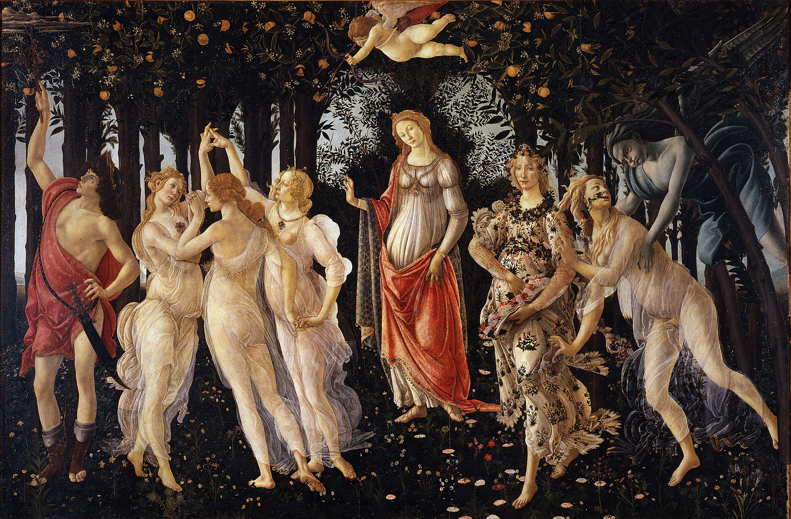
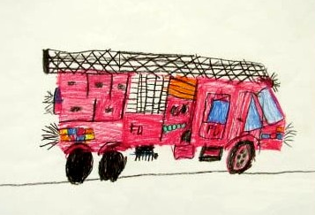
Some starting comments
TMC necessarily involves many random files which will never be validated (or read by a human?). Quality of the TMC is only as good as the quality of these (perturbed parameter) files which…
You think look like this…
But may look like this…
Careful with
HOMPOL…

Slide 14
A few cautionary thoughts
Model simulations are designed to be faithful to (semi-empirical) physics, not to discontinuities which are inherent to experimental methods
GEF may be able to match the yields of evaluated files quite well, since these are (hopefully) physically consistent, but how do we reconcile uncertainties which are not based on model/theory?
‘Unique’ files with strange results may slip through file generation and some simple checks, but will skew results, particularly variances which are sensitive to outliers
  Effort required to cull the ugly files…
Stochastic ND codes must only be used where noise is much less than parameter-induced variation, for burn-up markers, this is strict

Slide 16
Convergence with TMC
  Convergence of GEF calculations for U235_th nFY (1.0E+05 to 1.0E+08)

Slide 17
Convergence with TMC
  nFY TMC with PWR UO2 assembly averaged Nd148 at shutdown, after 40GWd/tn
  nb: For Nd148, known to ~0.6% cumulative, need much less than 1% noise

Slide 18

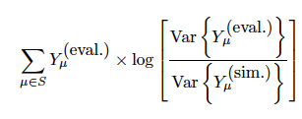
GEF and Evaluated Unc.
To fit the evaluated yields, there is a natural fitness function:
At least two sources for uncertainties to match: evaluation or experiment
  Experiment is preferable for many reasons, but this is not for the faint-hearted. Unwinding cumulative yields, differences between decay files, experimental bias for good or bad… I am not so brave…
  Choosing the evaluated data is a much easier task. Moreover, reactor operators are (probably) not going to prefer GEF-calculated uncertainties for their fission products of interest, irrespective of quality.
To approach exp. variances we define a fitness function which accounts for var(simYields):

Slide 19
Yield sensitivities
To best fit the evaluated variances, some updating algorithm for the parameter variances is required, using the sensitivity of the yields to the input parameters:

Slide 20
Updating
Approach prototyped is quite simple:
  Mean values fixed as end-of-optimisation values from Rochman et al BMC method*
  Variance seeds taken as default GEF ratios of default GEF parameters
  Sets of files are generated with Gaussian samples over all parameters
  Statistical collapse of sampled files compared with evaluated data
  Parameter variances are gently nudged based on sampled-to-evaluated fitness of all reasonably converged (and post-cull) yields
  Continue until update has no/little effect
Result depends on fitness function, path to minimum and target
*DOI: 10.1016/j.anucene.2016.05.005

Slide 21
Variance update prototype
Can design parameter updating algorithms to push input variances toward reproducing evaluated uncertainties, but only as far as the physical model can cooperate with the evaluated uncertainties…
Can’t hit all nuclides/chains

Slide 22
Comments on covariances
Independent covariances intuitive based on simulation of fission events (independent correlation chart for Nd148 GEFY-5.3 U5_th)
This is 1 ‘column’

Slide 23
Comments on covariances
Cumulative covariances and covariances from full irradiation scenarios show completely different trends (assembly 40 GWd/tn)

Slide 24
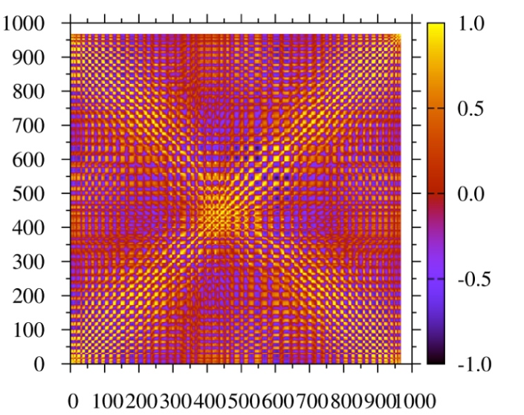

The exp v model question
Several nuclides are evaluated at <1% uncertainty in cumulative, eg Nd148 or other markers
These are correlated physically with others with > several % uncertainty, posing a problem for the file sampling TMC method
  These are the heart of nFY evaluation and cannot be missed!
There is no medical(science)-based solution, we must operate…

Slide 25
Covariance transplant
One simple solution is to run separate optimisations which target global and local (specific low uncertainty) yields
Transplant of the former for targeted nuclides (eg Nd148) and their mass chains into physically consistent matrix for remainder (with higher uncertainties) could satisfy both physics/models & experiment
This is not a ‘Frankenstein’, but method of reconciliation between two semi-contradictory methodologies

Slide 26
FISPACT-II and nFY TMC
FISPACT-II can be used to fully sample random independent (or cumulative) yield files with any decay library, propagating uncertainties through full fuel life-cycle*
*Taken from upcoming NDS paper D. Rochman et al

Slide 27
FISPACT-II RR + nFY UQP
Coupling FISPACT-II covariance UQP for reaction rates with TMC we can provide coupled uncertainties:
  From unc. of fissions and production of fissionable nuclides
  From unc. in fission yields
  And the coupled nFY + RR unc.
Takahama SF97-1 after 45 MWd/TU
Bands x10 for visualisation

Slide 28
Conclusions
TAGS fixes have converged for ENDF/B and JENDL, more experiments and evaluations needed but agreement is reassuring
Fission yields for reactor operation have uncertainties due to measurement techniques, interest in nuclides, normalisation choices
A physically-faithful code with natural parameter variation cannot be reconciled with discontinuities of evaluated uncertainties
A physically-faithful code with massaged parameter variation may complement uncertainties and correlations for evaluated methods, potentially with covariance matrix surgery, problematic for TMC
To couple with full, unconstrained nuclear data we must have open, exploratory/predictive simulation tools, such as FISPACT-II

